Slide 1


Deng AI
Predicting Disease Spread

Slide 2
Agenda
Problem Overview
Data Preparation
1
Exploratory Data Analysis
2
Model Development
3
Conclusion
4
Next Steps: Phase II
5
6
Notes:
For the presentation, please focus on the key points, storytelling and visuals

Slide 3

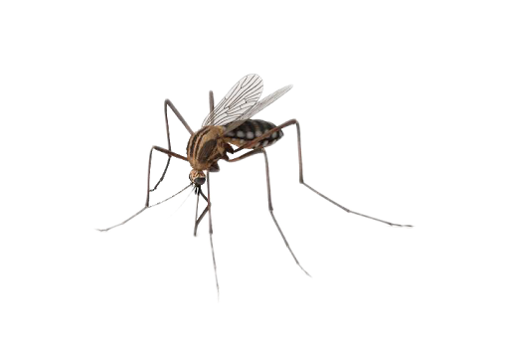
Problem Overview
Climate Variables
Mosquito Density
Key Drivers of Dengue Fever
We have to predict the number of dengue fever cases reported each week in San Juan and Iquitos, based on environmental data describing changes in temperature, precipitation, vegetation, and more.
Notes:
Dengue fever is a mosquito-borne disease that occurs in tropical and subtropical parts of the world.
The transmission dynamics of dengue are related to climate variables such as temperature and precipitation.

Slide 4

Data Preparation
Merging Data
Converting Features
Imputation
Combined training data and training data labels based on city,year,weekofyear.
To keep consistency among all features, the ones with Kelvin were converted to Celsius.
Used ffill() function to fill the missing value in the dataframe. 'ffill' stands for 'forward fill' and will propagate last valid observation forward.

Slide 5
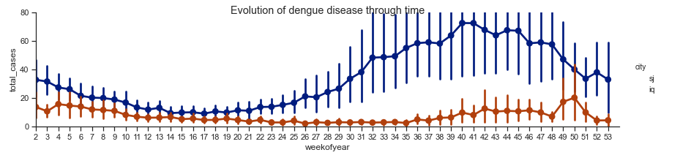
Exploratory Data Analysis
We can see a trend in San Juan that the dengue virus becomes more active in the later half of the year- July (week 28).
On the other hand in Iquitos, dengue developed quite slowly, with its peak at the end of the year-week 50.

Slide 6
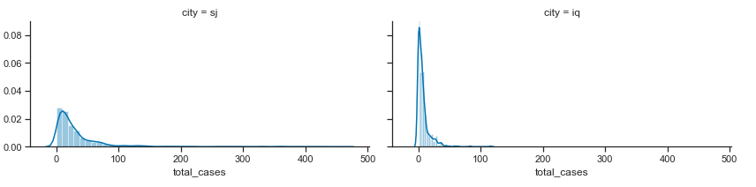
Exploratory Data Analysis (contd.)
City | Mean of Total Cases | Variance of Total Cases
IQ | 7.6 | 115.9
SJ | 34.2 | 2640
Notes:
Variance: variance is the expectation of the squared deviation of a random variable from its mean. In other words, it measures how far a set of numbers is spread out from their average value.

Slide 7
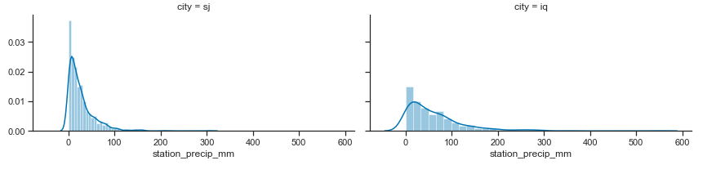
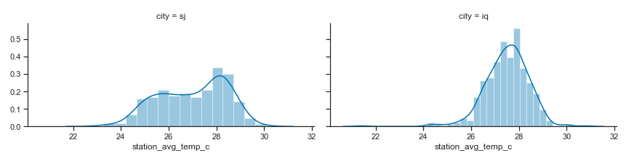
Exploratory Data Analysis (contd.)

Slide 8
Considerations Based On EDA
Dengue fever is a tropical disease, so it is expected to be more in places with high temperature/precipitation and thus high humidity.
San juan is a city on an island and has a much lower population density than Iquitos.
Separate the data for each city
Iquitos is in Peru and a port city. It gateway to the jungle and tribal villages of the northern Amazon.
It is transmitted by mosquitoes, who are common in summer.

Slide 9
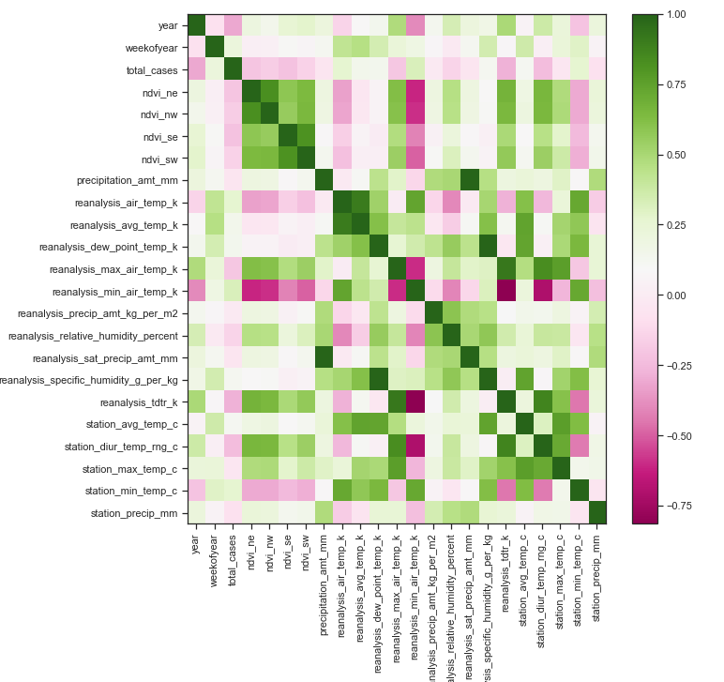
Feature Engineering
Check correlation and remove highly correlated features

Slide 10
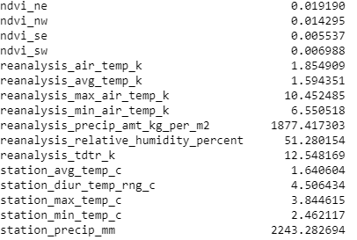
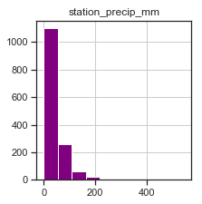
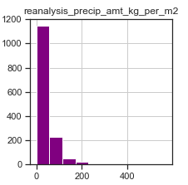
Feature Engineering (contd.)
Check which features have high variance
Remove the features with higher variance so they don't impact the results.
Assumption:General incubation period of virus is 4-7 days so it is assumed that the number of cases in a given week are related to previous week.
Experiment: Data shifted (# of cases) by 1 week.

Slide 11

Model Development
Model training and Performance Measurement
Gradient Boosting Regressor Selected as the best performing model
City | MAE
IQ | 4.5
SJ | 16.8
Data preprocessing
Dataset split into train and test data set
Notes:
Data Preprocessing:
Standard Scaler: StandardScaler removes the mean and scales the data to unit variance. StandardScaler therefore cannot guarantee balanced feature scales in the presence of outliers.
Robust Scaler: the centering and scaling statistics of RobustScaler is based on percentiles and are therefore not influenced by a few number of very large marginal outliers.
*when data contains outliers, StandardScaler can often be mislead. In such cases, it is better to use a scaler that is robust against outliers.
MinMaxScaler rescales the data set such that all feature values are in the range [0, 1] as shown in the right panel below. However, this scaling compresses all inliers into the narrow range [0, 0.005] for the transformed number of households.
Both StandardScaler and MinMaxScaler are very sensitive to the presence of outliers.
StandardScaler follows Standard Normal Distribution (SND). Therefore, it makes mean = 0 and scales the data to unit variance.
MinMaxScaler scales all the data features in the range [0, 1] or else in the range [-1, 1] if there are negative values in the dataset. This scaling compresses all the inliers in the narrow range [0, 0.005].
In the presence of outliers, StandardScaler does not guarantee balanced feature scales, due to the influence of the outliers while computing the empirical mean and standard deviation. This leads to the shrinkage in the range of the feature values.
By using RobustScaler(), we can remove the outliers and then use either StandardScaler or MinMaxScaler for preprocessing the dataset.
It scales features using statistics that are robust to outliers.

Slide 12
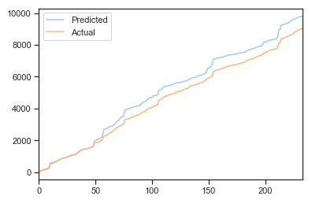
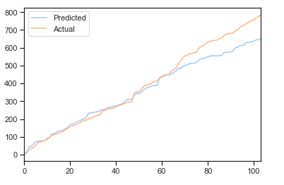
Model Development (contd.)
City: San Juan
City: Iquitos
Notes:
Mean Absolute Error of your model refers to the mean of the absolute values of each prediction error on all instances of the test data-set. Prediction error is the difference between the actual value and the predicted value for that instance.

Slide 13
Conclusion
More traditional machine learning approaches outperformed the tried neural network model.
Results can be further improved by doing more feature engineering based on domain knowledge.
Further work can be done to determine if more sophisticated neural network architectures (such as seq2seq and UFCNN) are capable of producing better results for dengue prediction.

